Slide 1
IOTA Community Logo
IOTA
The distributed communication layer of tomorrow

Slide 2


DISCLAIMER:
NO FINANCIAL ADVICE WILL BE GIVEN IN THIS PRESENTATION
Notes:
Still relevant until Dan gives financial guidelines about the Token

Slide 3
Index
whoami/whoarewe
IOTA Libraries
The IOTA Foundation
Use Cases
What today is about

Slide 4
Index
whoami/whoarewe
IOTA Libraries
The IOTA Foundation
Use Cases
What today is about

Slide 5


whoami/whoarewe
Name Surname
Your Title - yourwebsite.com
Following distributed ledger technology since 2011
Love free and open source software
Project with local company
Notes:
Present the organizers, speakers, supporters
Examples:
Your title, your line of work
what you do
when you started following IOTA

Slide 6
whoami/whoarewe
Name Surname
Your Title - yourwebsite.com
Following distributed ledger technology since 2011
Love free and open source software
Project with local company
Notes:
Present the organizers, speakers, supporters
Examples:
Your title, your line of work
what you do
when you started following IOTA

Slide 7
whoami/whoarewe
Name Surname
Your Title - yourwebsite.com
Following distributed ledger technology since 2011
Love free and open source software
Project with local company
Notes:
Present the organizers, speakers, supporters
Examples:
Your title, your line of work
what you do
when you started following IOTA

Slide 8




Technology
Governance
Ecosystem
Notes:
Important Puzzle Pieces
The Tangle and IOTA technology
The Governance by the IOTA Foundation
The Ecosystem around IOTA

Slide 9

The Tangle
The Tangle is the immutable data structure that contains a history of IOTA transactions.
Notes:
The Tangle is the immutable data structure that contains a history of IOTA transactions. All nodes in an IOTA network store a copy of the Tangle in their ledgers and can read from it and attach new transactions to it.
This removes completely the need to pay fees to miners and thus opens up the possibility to execute microtransactions which could be worth as little as a few cents.
Besides, IOTA’s DAG data structure allows for the network’s easy scalability. Everyone is participating in reaching a consensus and, therefore, the more people are using IOTA, the faster the network becomes.

Slide 10

The Tangle
The unique data structure being utilized in IOTA
Directed Acyclic Graph (DAG)
Scalable distributed framework for transactions
Transactions can hold data, value or both
Consensus
Notes:
DAG - The references among transactions form a type of directed acyclic graph (DAG), which is a sequence of vertices where every edge is directed from an earlier point to a later one in the sequence (the animation shows the three dimensional version)
Scalability - When a node attaches a new transaction to the Tangle, that transaction directly references two existing ones (make a simple multiplication to show how numbers grow)
Consensus - Network nodes are responsible for validating transactions and their histories to make sure that they don't conflict.
When a node has a transaction's entire history, the transaction is considered solid, which means that it can be considered for confirmation.
Resources for the speaker:
https://docs.iota.org/docs/dev-essentials/0.1/concepts/the-tangle
Internal style notes for DRAFT and EVALUATION: The top right Tangle is a flair that with one or three given colors should hint to the content of the slide.
E.g.
Blue - Business
Green - Tech
Orange - Academia
Note: the colors are to be defined as the flair itself @Sabri

Slide 11
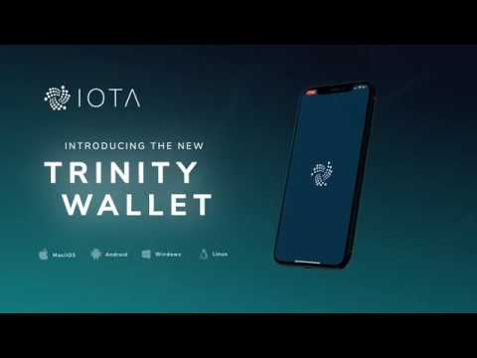
Trinity
https://youtu.be/kSHNwvQhDUY

Slide 12
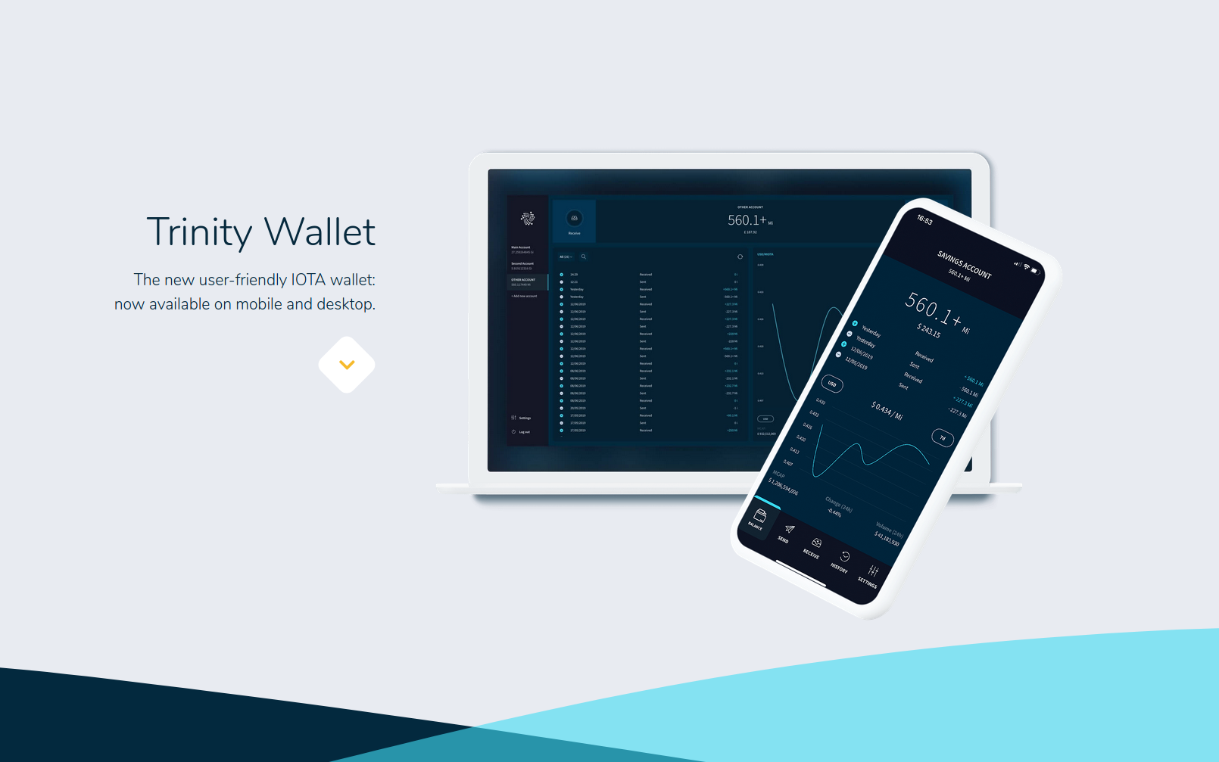
Trinity
Available on MacOS, Windows, GNU/Linux, Android, iOS
Desktop versions with Ledger Nano S and X support
Download at
https://trinity.iota.org

Slide 13
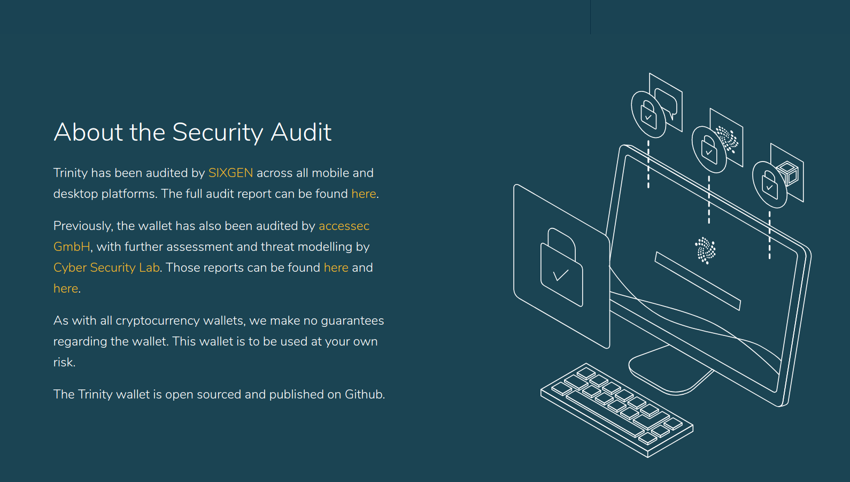
Trinity
Open Source:
https://github.com/iotaledger/trinity-wallet
Two security audits
Notes:
Resources for the speaker:
https://blog.iota.org/trinity-threat-modelling-mitigation-report-a1c183eb3970
https://files.iota.org/trinity/Trinity+Security+Audit+V1.4.pdf
https://files.iota.org/trinity/Threat+Modelling+Report+V1.2.signed.pdf
https://files.iota.org/papers/Trinity-Sixgen-Assessment.pdf

Slide 14
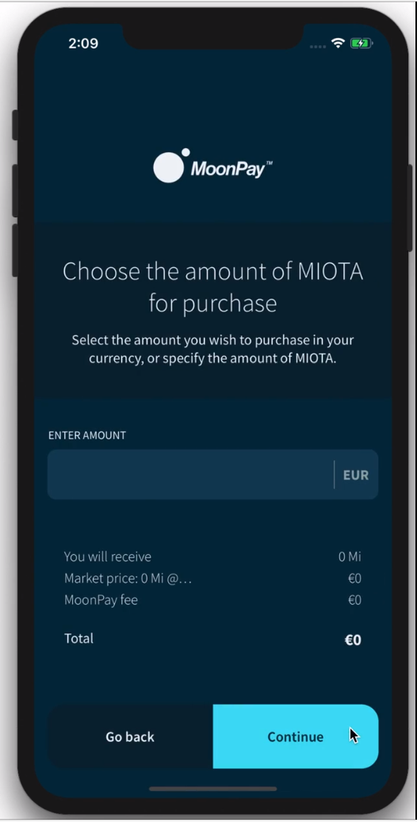
Trinity - 3rd party integration
FIAT/IOTA onramp
Seamless user experience for purchasing the IOTA Token
Test case to explore how non-traders will acquire IOTA Tokens in the future, without exchanges
https://thumbs.gfycat.com/BitesizedWelltodoLaughingthrush-mobile.mp4
Notes:
Resources for the speaker:
https://blog.iota.org/purchase-iota-directly-from-trinity-with-moonpay-f9d6b0a9faa4?source=collection_category---4------0-----------------------

Slide 15
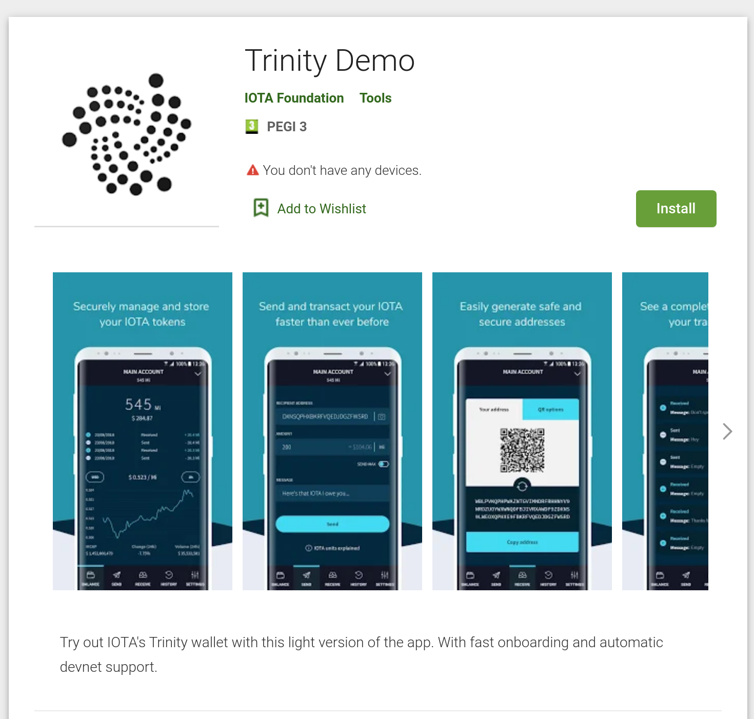
Trinity - Demo Wallet
Demo wallet for Android
Fast onboarding
Devnet support
Notes:
The iOS is on testflight, access through the Trinity Developers is required. (Discord)

Slide 16
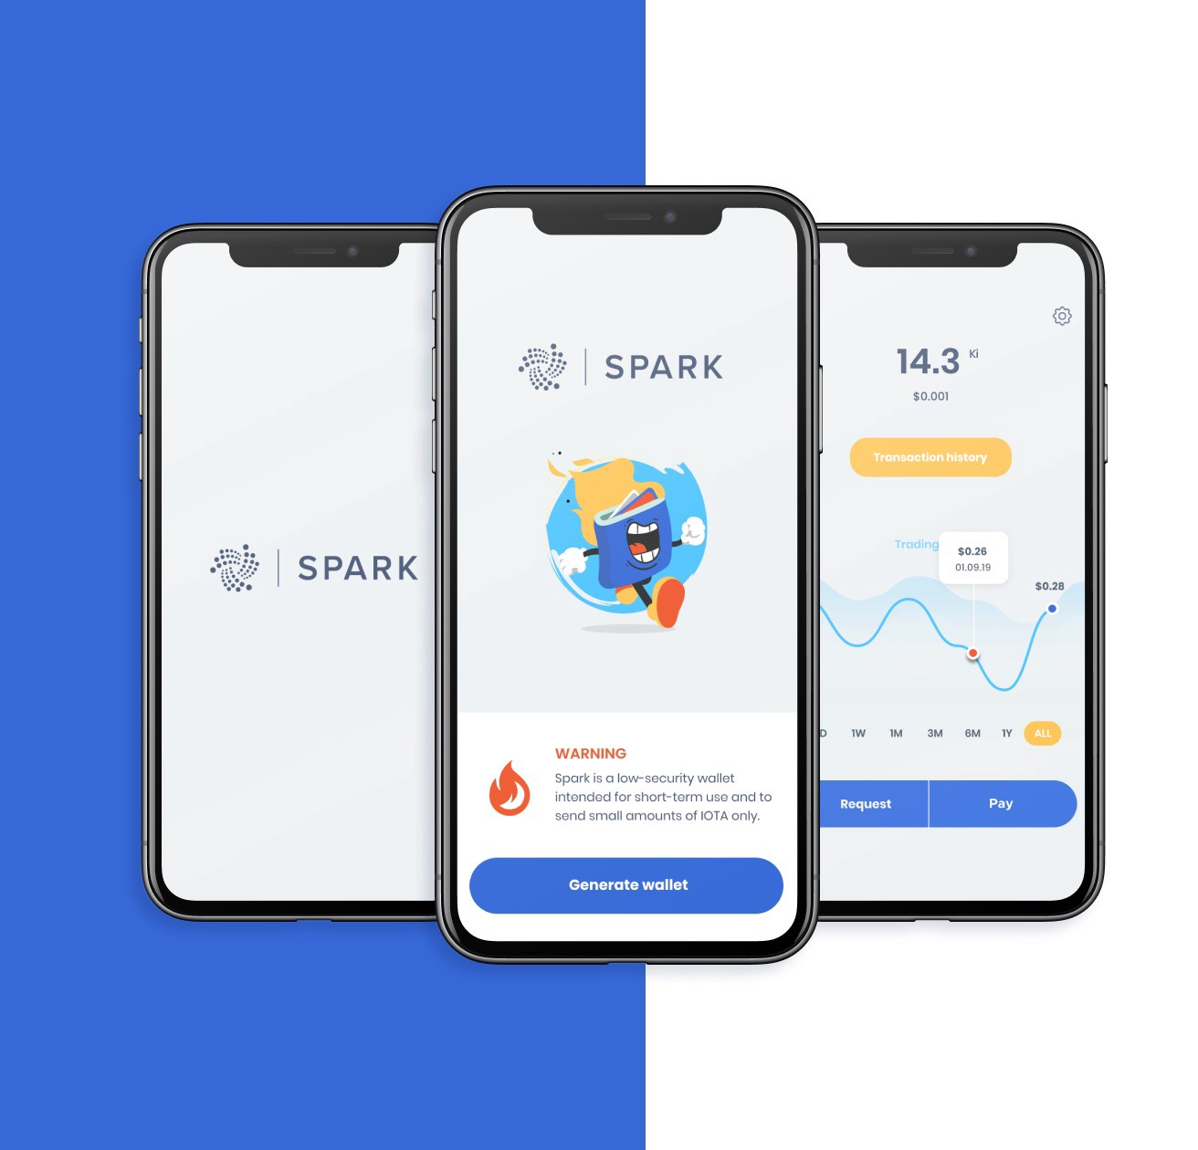
Spark - Burner wallet
Low-security, temporary web wallet, “burner wallet”
Fast onboarding
Build with Svelte
Devnet support
spark.iota.org
spark-devnet.iota.org
Notes:
IOTA Labs is a new project within the IOTA Foundation to funnel our experimentation into something tangible. Whenever we create an experimental app, we will release it under IOTA Labs. Spark is the first app to be released under IOTA Labs and has served as a testing ground for some new ideas and tools
Idea is that you use the wallet for small amounts of funds, for a short period of time, and then you “burn” it, wiping the seed and transaction history.
Spark makes use of the IOTA JavaScript account module. The account module introduced a new approach to tackling one-time use addresses in IOTA, using a payment request system.
Resources for the speaker:
https://blog.iota.org/announcing-spark-a-web-based-low-security-burner-wallet-91acab12e9df

Slide 17
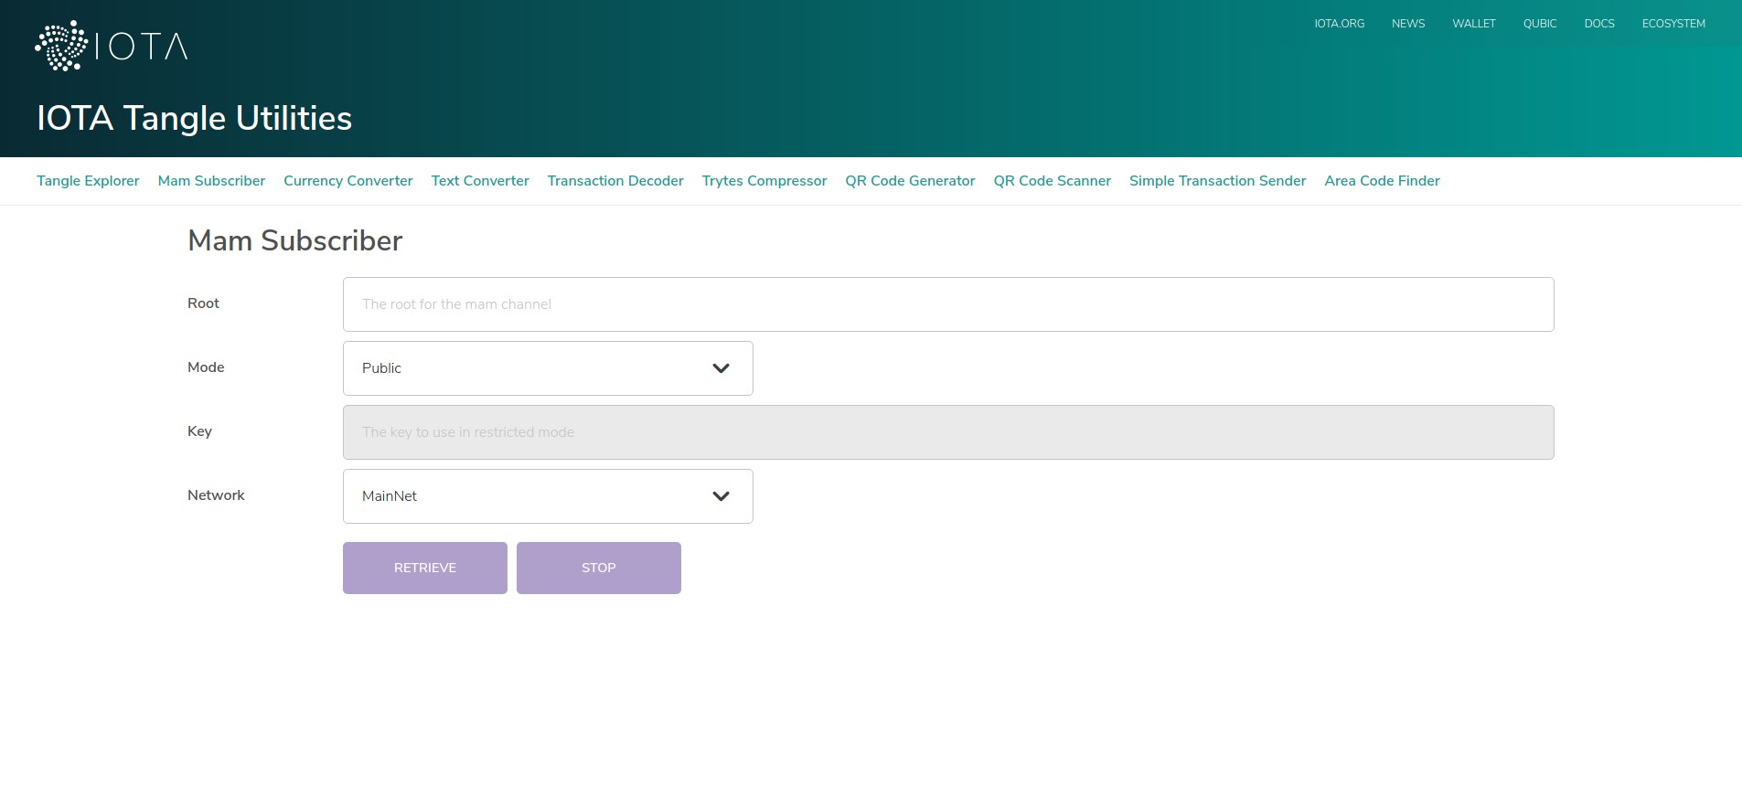
IOTA Utilities
spark.iota.org
Notes:
Resources for the speaker:
https://utils.iota.org/
https://docs.iota.org/docs/utils/0.1/introduction/overview
Tangle Explorer
IOTA Tangle Explorer is a simple tool which provides detailed information about any IOTA transaction, address, and bundle hash. Just enter any transaction id, address or hash and click on explore to get its details.
Mam Subscriber
Masked Authenticated Messaging is a data communication protocol that allows you to publish and fetch messages in encrypted data streams, called channels, on the Tangle. You can use the MAM package to publish encrypted and authenticated messages to channels. The Tangle allows you to attach zero-value transactions to it, but these transactions are not signed or checked by nodes to verify their authenticity.
Currency Converter
Convert from your preferred currency to IOTA tokens
Text Converter
Converts the text to to trytes, or the trytes to text
Transaction Decoder
Decode a transaction payload from trytes
Trytes Compressor
Store transaction trytes in a smaller memory space so you can later rebroadcast or reattach them.
QR Code Generator
Generate the QR code, only the address is required.
Once generated you will be able to scan the QR code into Trinity.
QR Code Scanner
Scan the QR code generated by the QR Code Generator

Slide 18
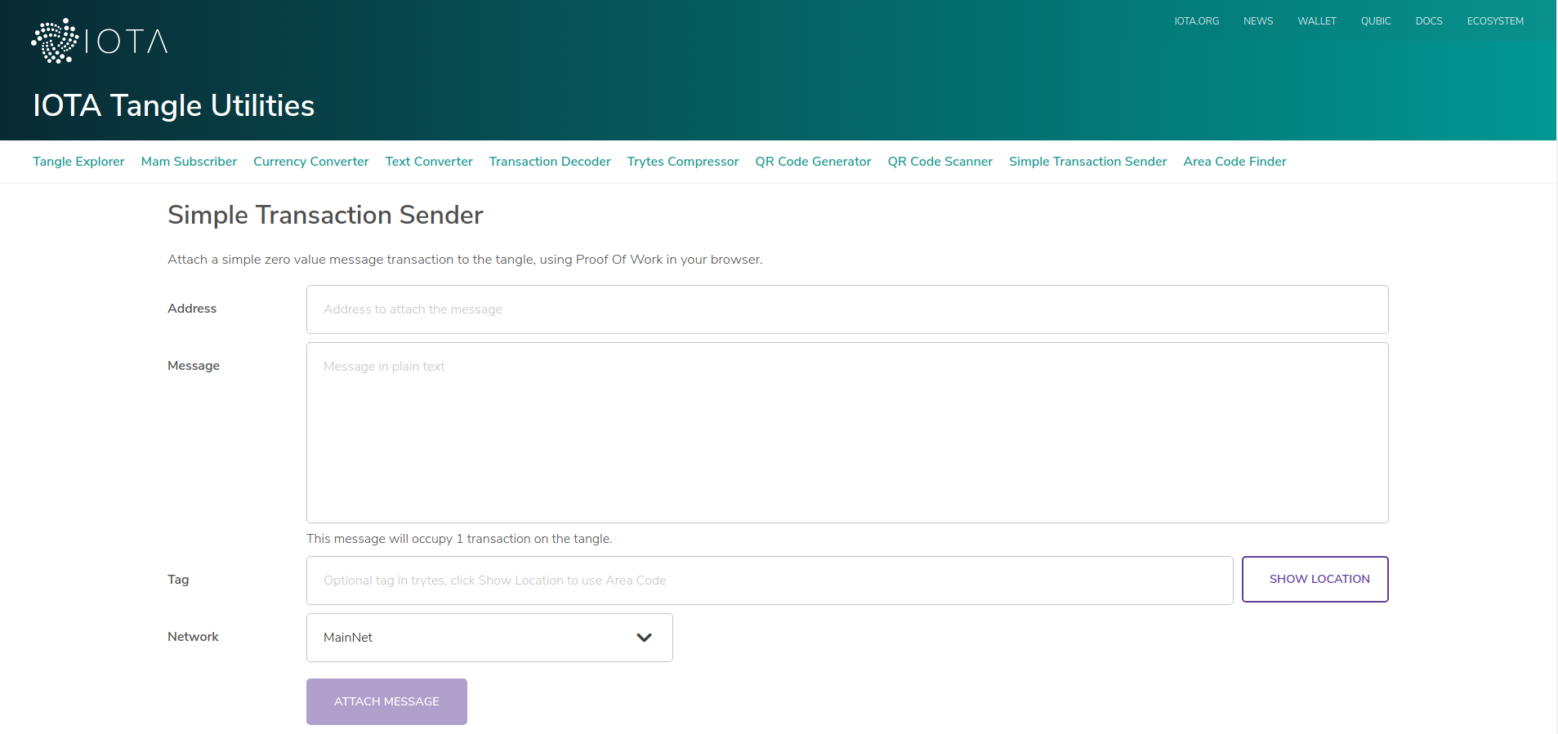
IOTA Utilities
spark.iota.org
Notes:
Simple Transaction Sender
Attach a simple zero value message transaction to the tangle, using Proof Of Work in your browser.

Slide 19
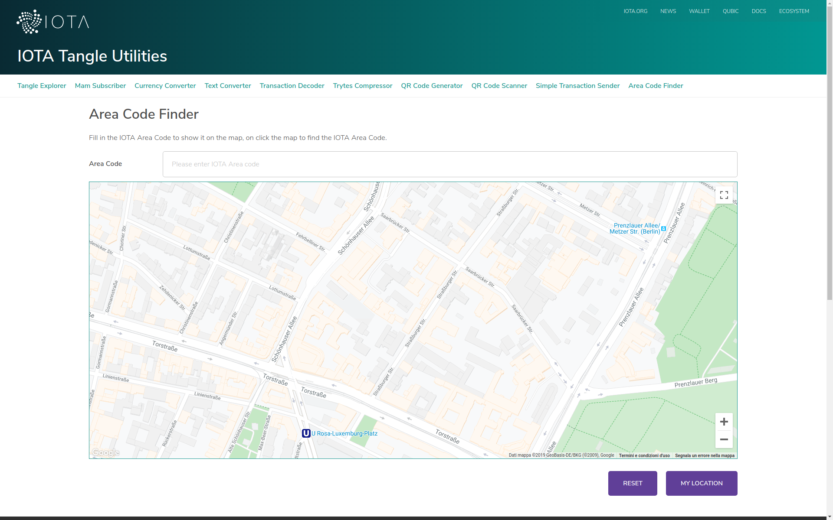
IOTA Utilities
spark.iota.org
Notes:
Area Code Finder
Tag an IOTA transaction with a geo-location, and find others with the same tag

Slide 20

IOTA Foundation - Vision & Goals

Slide 21

The IOTA Foundation
The IOTA Foundation - to research, develop and grow market adoption of DLT
Non-profit Foundation based and regulated in Berlin, Germany
Growth from 6 to 100+ full time employees distributed across 27 countries
Focused on technical and regulatory challenges of crypto-currencies & DLT
Notes:
Make sure to emphasise that IF's goal is to be irrelevant in 5 years. One of many actors guiding, building, using the Tangle

Slide 22

IOTA Ecosystem
Our universe relies on a network of many collaborators
– corporates, academics, governments, NGOs
Notes:
(give examples from Fujitsu, Lidbot, etc..)
Sources for Ecosystem:
http://iota-archive.com/

Slide 23

IOTA Ecosystem
Meet the IOTA Ecosystem
Tutorials
Projects
Events
Developers
Notes:
The IOTA Ecosystem is a hub of education, innovation, tools, collaboration and development for the IOTA distributed ledger protocol and is lead by the IOTA Foundation.
The Ecosystem also is responsible for the Ecosystem Development Fund.
Resources for speaker:
https://ecosystem.iota.org

Slide 24

IOTA Ecosystem Development Fund
Funding for projects in the IOTA Ecosystem
Proof of concepts
Open source utilities and libraries
Educational resources
Media
Philanthropic endeavors
Hackathons
Ideation workshops
Meetups
Notes:
Ecosystem Development Fund Is a collection of donations that are granted to IOTA related projects
Is committed to Transparency, accountability and by memorializing EDF funding agreements with ‘Proof-of-Existence’ transactions on the Tangle, anyone will be able to verify that agreements the EDF enters existed in a certain state at a certain point in time. The IOTA community can thus hold both the EDF and the benefactors of EDF
Resources for speaker:
https://fund.iota.org

Slide 25

Coordicide Grant Program
Research Grant
Optimization of the networking layer to avoid network congestion
Reputation system based on node behavior
Theoretical behavior of cellular automata based consensus
Theoretical properties of query-based voting schemes (e.g., FPC)
https://coordicide.iota.org/grants
Notes:
This project is IOTA’s top priority, and there is the possibility to collaborate through the Coordicide grant program, which offers both large and small grants for research on any aspect of Coordicide.

Slide 26

AION - Selective Permanode
Selective permanode solution
Keeps a pruned Tangle mathematically intact
Developers can host their own data
Data becomes transferrable
Ecosystem developer fund grantee
Notes:
Developers can host their own data
Right now if you are developing with IOTA and don’t want your Proof of Concept have it’s data removed all the time from an immutable ledger then you are stuck with hosting the entire tangle and disable snapshotting.
With AION you will be able to do snapshotting and keep the data that is only relevant to your application. Important to mention is that this works in constant time. Meaning that the variations in Transactions Per Second will NOT influence your personal storage requirements.
Data becomes transferrable
The unique way AION describes what needs to be stored also introduces a way to efficiently communicate what data you want from other nodes. Allowing you to push a certain subset of the Tangle from one node to another. Creating the ability to do data replication for important data, like Digital Identity. Or just for the sake of back-ups.
Resources for speaker:
https://medium.com/coinmonks/aion-33e01538dadf
https://www.youtube.com/watch?v=giatJB-j2pE&t=1962s

Slide 27

Hornet - IOTA Fullnode
Entirely written in Go
IOTA fullnode on low-end devices such as a Raspberry Pi
Ecosystem developer fund grantee
Notes:
Resources for the speaker:
https://blog.iota.org/the-5th-cohort-of-iota-ecosystem-development-fund-grantees-5cbf05227525
https://medium.com/@gohornet/milestone-1-the-hornet-awakens-7199cb6c69e7

Slide 28
Contacts:
Sponsors:
Get involved:
email@provider.com
website.com
twitter.com/myhandle
linkedin.com/in/mylink
<SPONSOR NAME>
<Description>
sponsor.website.com
Website:
Ecosystem:
Discord:
Twitter:
LinkedIn:
YouTube:
www.iota.org
ecosystem.iota.org
discord.iota.org
twitter.com/iotatoken
linkedin.com/company/iotafoundation
www.youtube.com/c/iotafoundation

